Slide 1
[open app]
Uh-Oh Need to set up your profile
Profile Setup
Log In
[profile not created]
[select edit]
[submit info]
[log in]
[select sign up]
Self Profile
Searching...
Sign Up
[profile created]
Connections
Venue Select
Messages
User Message
User Profile
Venue Search

Slide 2
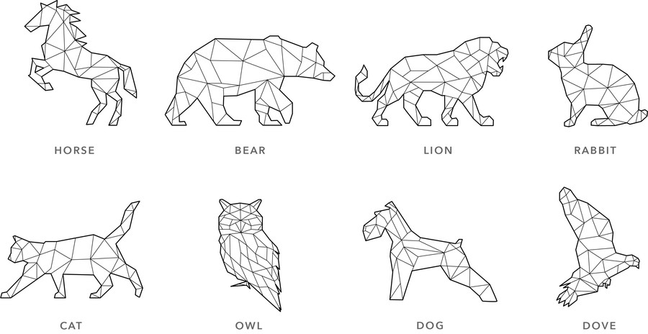
Login Screen
Placeholder logo
Placeholder name and treatment
Polar
Email or username
Password
Login fields
Log In
Log in using information in fields
Facebook
Instagram
------ OR ------
Make an Account
Log in immediately using Facebook or Instagram account
Criteria: Open application on smartphone.

Slide 3
Sign Up Screen
User selects avatar
First Name
Last Name
Email
Registration
fields
Password
Verify Password
Sign Up with Facebook
Sign Up with Instagram
Finish registration by linking to Facebook or Instagram account
Criteria: Select “Make an Account” from Login.

Slide 4

Loading Screen
Loading...
Criteria: Intermediary screen while application loads.

Slide 5




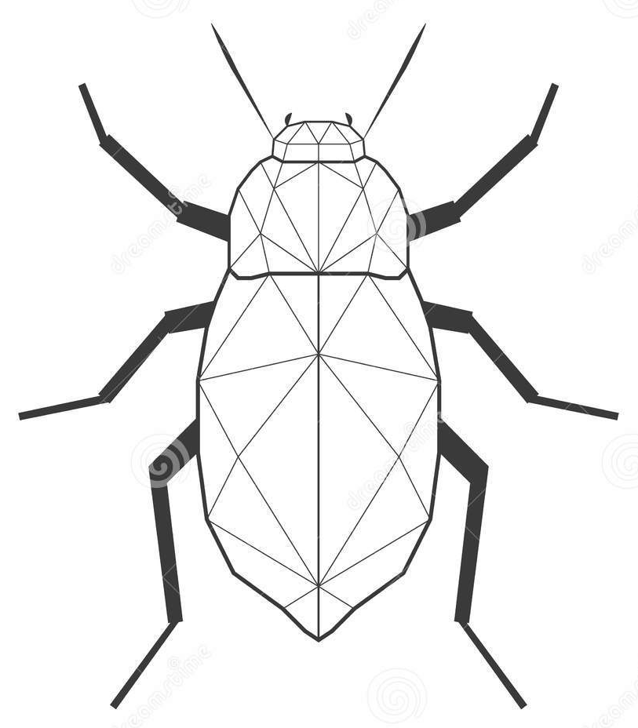

Connections Screen
Application header:
- Open menu - Help button - Show user map
Clive
Healthcare
Poverty
View
Liz
Recommended user list
Environment
Poverty
View
Sarah
Abbreviated user profile
Environment
Healthcare
View
Chris
Environment
Shared interests between primary user and other users
Poverty
View
Button that links to selected user’s profile
Criteria: 1) Log in with complete profile, or 2) Select “Connections” from another screen

Slide 6
User Profile Screen
Application header:
- Open menu - Help button
Sarah
User’s name and avatar
You both care about…
Environment
Areas of shared interest
Healthcare
What Sarah values most in a friendship.
I value honesty and integrity. Someone with these traits is someone I consider to be of high character.
Additional profile information
Informs user of interest in meeting
LET’S CHAT
LET’S MEET
Sends user a message
Criteria: Select user from Connections.

Slide 7
Incomplete Profile Screen
Message informing user they must fill out their profile before continuing
Uh oh…
Looks like you haven’t responded to any questions, would you like to now in order to make connections?
Returns user to main menu
OK
LATER
Takes user to Edit Profile
Criteria: Attempt to load homepage or browse connections without a complete profile.

Slide 8
Edit Profile Screen
Forward button progresses to additional questions. Back buttons returns to previous screen.
CAUSES
Climate Change
Environment
Healthcare
Prompts user to select their passions. Key piece of information for matching algorithm.
Homelessness
Poverty
Women's Health
What do you value most in a friendship?
Enter text here…
Example question user may be asked to answer
Criteria: 1) Select “OK” from Incomplete Profile, or
2) Select “Edit” from Profile

Slide 9
Venue Search Screen
Application header:
- Open menu - Help button
FIND A VENUE
SEARCH
Dropbox to select preferred distance from location
Select search radius.
Select location.
Allows user to select “Near Me” or choose alternate location
CATEGORIES
Select venue type.
Location form entry. Only enabled if user selects alternate location.
Select ambience.
Select user rating.
LET’S MEET
Search
Optional additional search terms
Criteria: Both users select “Let’s Meet” from User Profile.
Sends request to Venue Results using specified parameters.

Slide 10




Venue Results Screen
Application header:
- Open menu - Help button - Show venue map
Morton Arboretum
Outdoors
Quiet
View
Steep & Brew
Recommended venue list
Coffee Shop
Quiet
View
Sidetrack Bar
Abbreviated venue profile, including name, user rating, type, and ambience
Bar/Lounge
Noisy
View
Shedd Aquarium
Cultural Venue
Noisy
View
Button that links to selected venue’s page
Criteria: Perform a search using Venue Search.

Slide 11
Venue Screen
Back buttons returns to search. Forward button shows more venue information, including hours, address, weblink, and photos.
Morton Arboretum
Great place to talk with Sarah about your shared interest in...
Climate Change
Outdoors
General information about venue, including relevant shared interests with match.
The Morton Arboretum, a 1,700-acre living museum, champions trees throughout the world via scientific study, conservation, and advocacy.
SUGGEST LOCATION
Sends matched user venue suggestion
Criteria: Select venue from Venue Results.

